Slide 1
Analyze International Debt Statistics
(Wireframe Documentation)
Author: Amit Sharma
Date: 3-08-2024

Slide 2
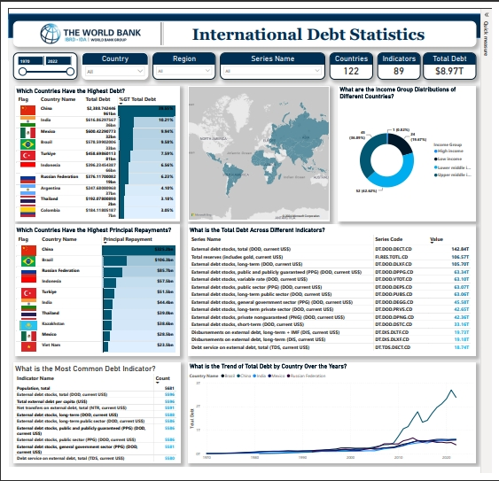

Slide 3
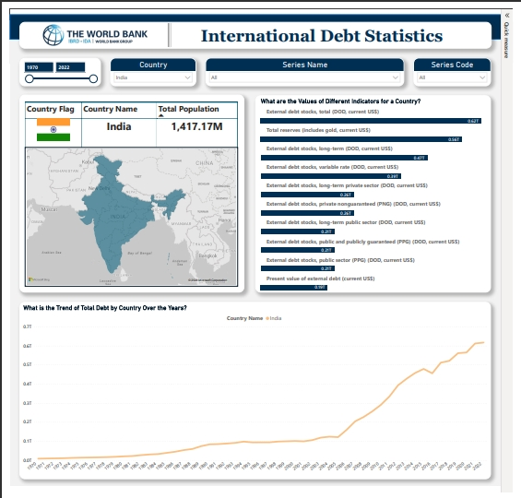

Slide 4
Insights from International Debt Statistics Dashboard
Overview
Our dashboard presents a comprehensive analysis of international debt statistics from 1970 to 2022, covering 122 countries and 89 different debt indicators. The aim is to provide clear insights into the global debt landscape, identify trends, and highlight key metrics.
Key Findings
Countries with the Highest Debt:
China leads with a total debt of $2,388.74B, constituting 39.35% of the global total.
India follows with $616.86B, representing 7.50% of the global debt.
Other significant contributors include Brazil, Mexico, and Turkey.
Principal Repayments:
China again tops the list with $325.2B in principal repayments.
Brazil and the Russian Federation are also notable for their high repayments, indicating significant debt servicing commitments.
Debt Indicators:
The most common indicators include external debt stocks (total), total reserves, and external debt stocks, long-term.
External debt stocks (total) dominate, with a value of $142.84T.
Income Group Distribution:
The pie chart reveals that the majority of the debt is held by upper-middle-income countries, followed by lower-middle-income countries.
Trends Over Time:
The trend graph shows a significant increase in total debt for countries like China and India, especially from the 2000s onwards.
Notable spikes in debt levels are observed around the global financial crises, indicating economic vulnerabilities.

Slide 5
Interactive Features
Filters: Users can filter data by country, region, series name, and series code to tailor the insights to specific needs.
Maps and Charts: Interactive maps and charts provide a visual representation of debt distribution and trends.
Recommendations
Policy Focus: Countries with high debt and repayments should focus on sustainable debt management strategies.
Economic Diversification: High-debt countries might benefit from diversifying their economies to reduce dependency on debt.
Further Analysis: Additional analysis on the impact of debt on economic growth and development could provide deeper insights.
Conclusion
The dashboard offers a detailed and interactive way to explore international debt statistics, helping policymakers, economists, and analysts to make informed decisions.

